Slide 1

Loan Prediction Analysis Using Machine Learning with Explainable AI
Embark on a journey of predictive modeling to determine loan approval status using machine learning techniques in this project.

Slide 2

Objectives
To predict the likelihood of a loan applicant defaulting on the loan by end-to-end Machine Learning Solution with SHAP Explainability.
Key Points
Target Variable: Loan_Status (Approved = 1, Not Approved = 0)
Features Include:
Numerical: ApplicantIncome, CoapplicantIncome, LoanAmount
Categorical: Gender, Married, Education, Property_Area, etc.

Slide 3





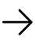


Project Workflow
Data Preparation
Feature Engineering
Preprocess and clean the dataset to ensure quality input for models.
Create new features to enhance model performance and insights.
Model Training & Explainability
Visualization
Use plots like heatmaps, violin plots, Sankey diagrams, and radar charts to explore data patterns.
Train models and explain predictions using SHAP values for interpretability.

Slide 4
Dataset Overview
6141
13
Source
Rows
Columns
Analytics Vidhya's Loan Prediction Practice Problem
Individual loan applications records included
Features describing borrower and loan details

Slide 5
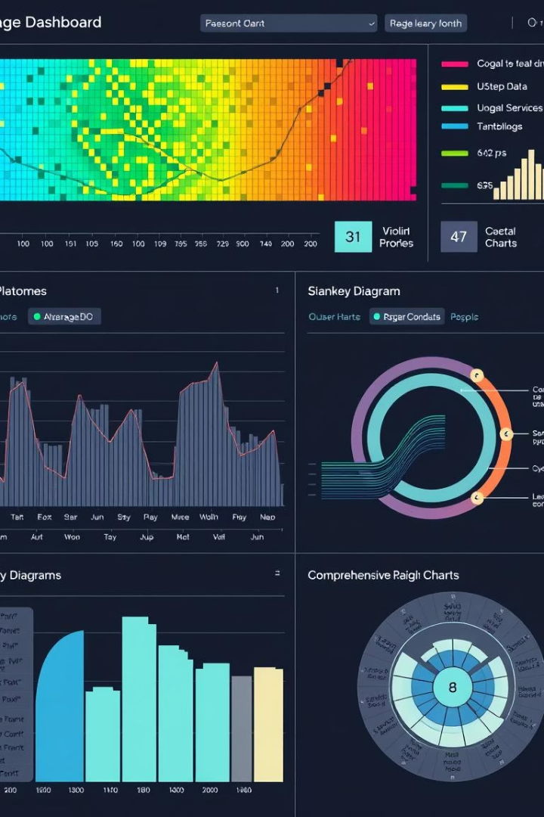



Data Preprocessing Techniques
Missing Values Handling
Imputed missing data using mode or median based on feature type.
Categorical Encoding
Applied one-hot encoding to transform categorical variables into numerical format.
Outlier Handling
Used Winsorization to cap extreme values at the 5th and 95th percentiles.

Slide 6
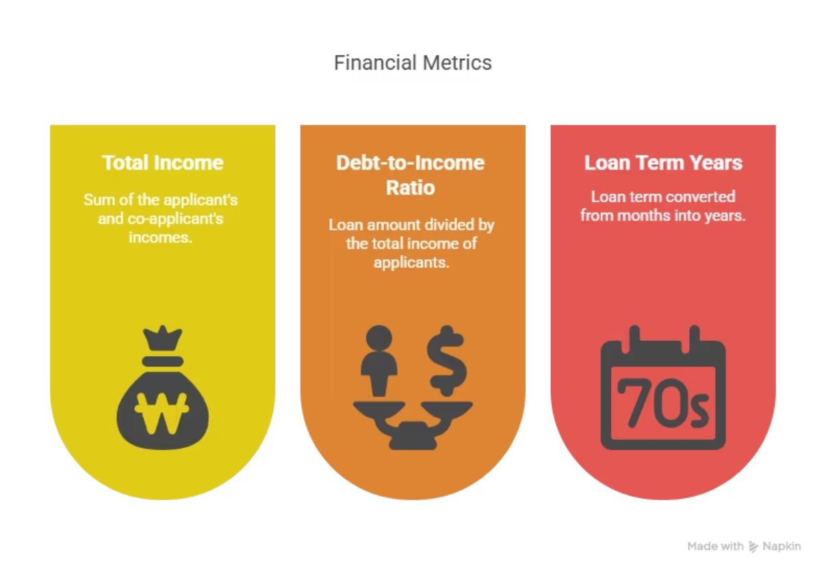
Feature Engineering Highlights

Slide 7
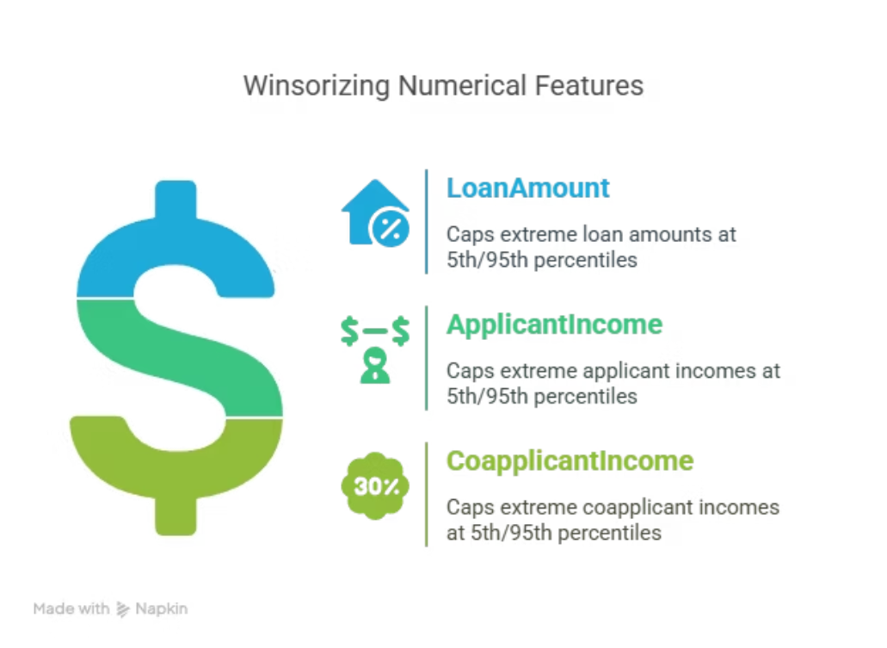
Winsorization
A technique to limit extreme values in data by capping them at a certain percentile.Values below the 5th percentile and above the 95th percentile were capped.

Slide 8
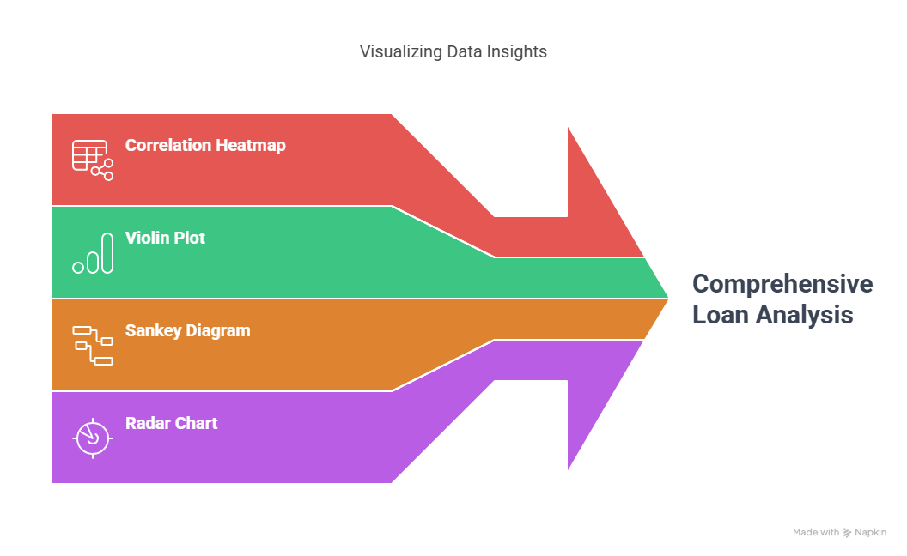
Data Visualization Insights

Slide 9

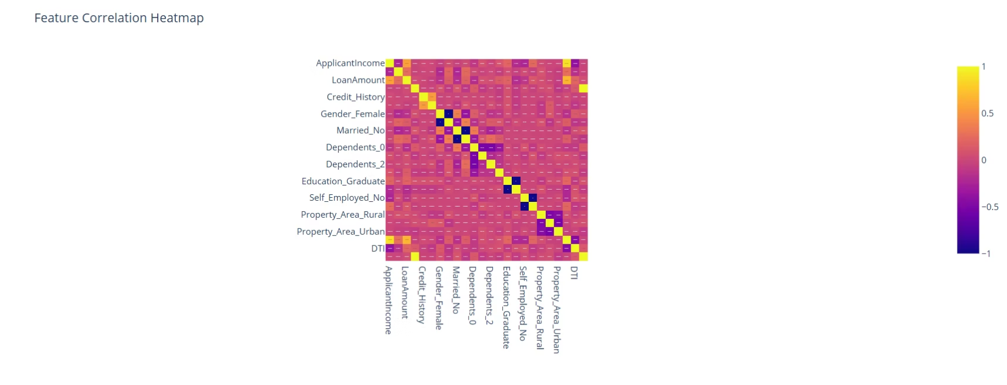
Correlation Heatmap

Slide 10
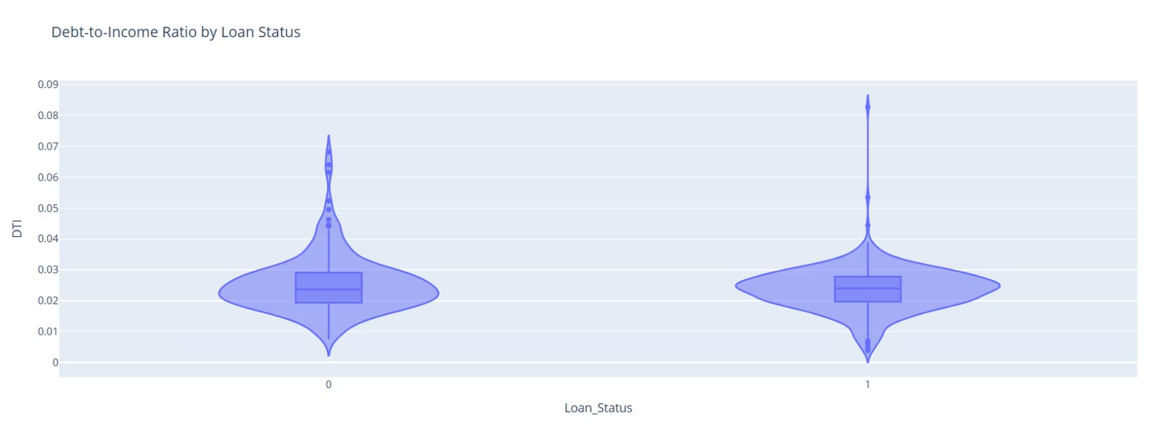
Violin Plot

Slide 11
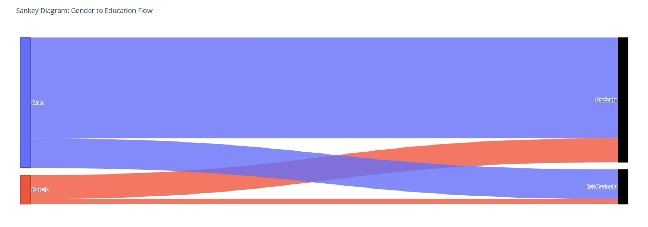
Sankey Diagram

Slide 12
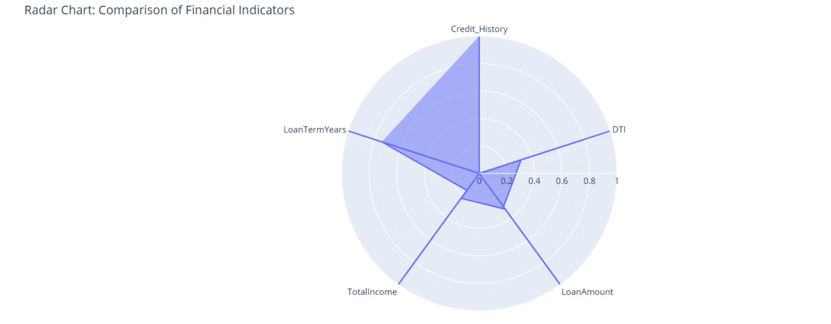
Radar Chart

Slide 13
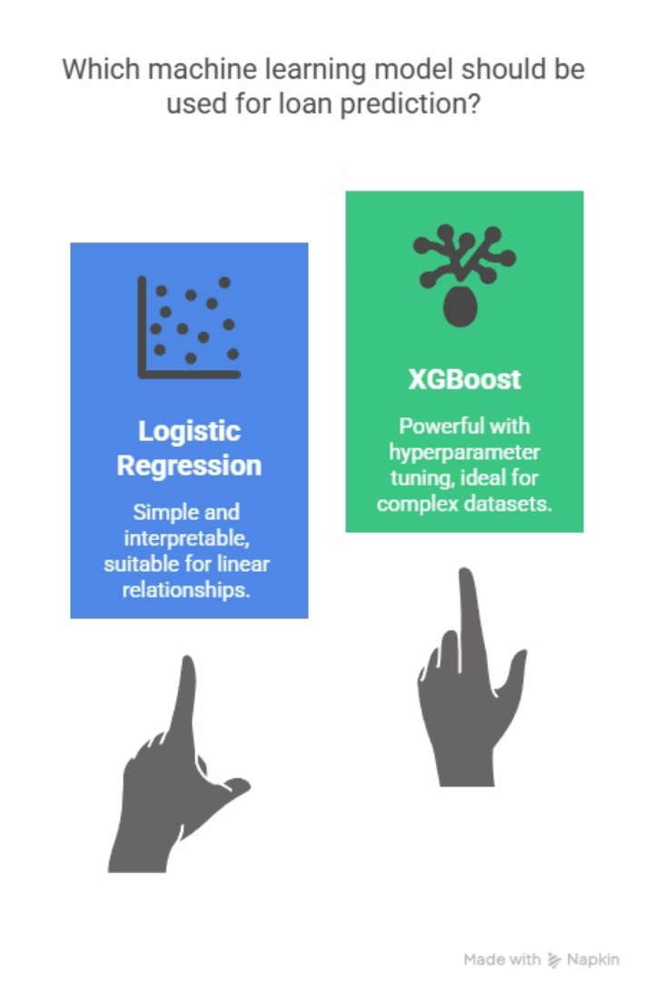


Model Development
Logistic Regression
Baseline model for binary classification of loan approval.
XGBoost
Supercharged XGBoost model with advanced hyperparameter tuning for razor-sharp accuracy.

Slide 14
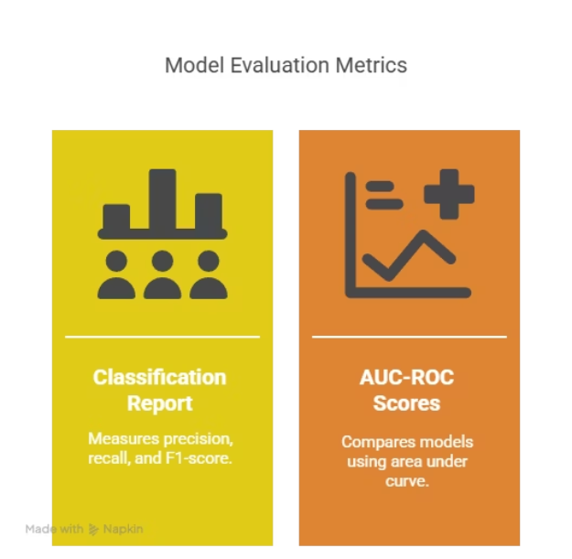
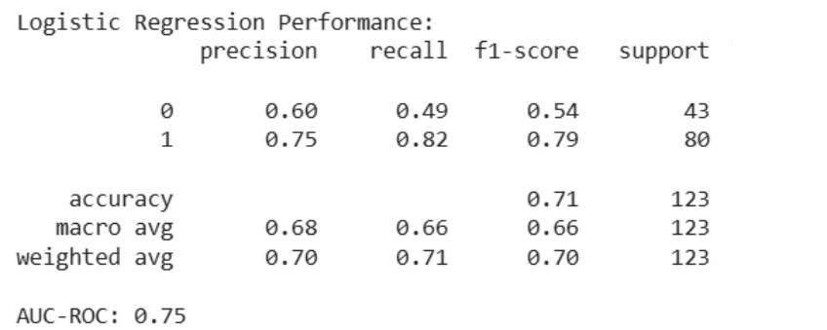
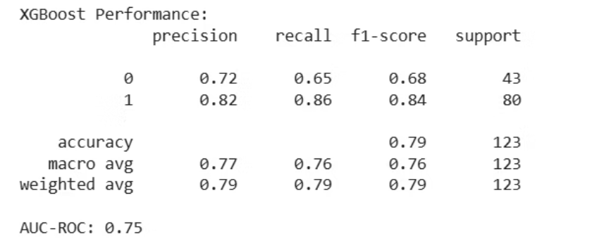
Evaluation Metric

Slide 15
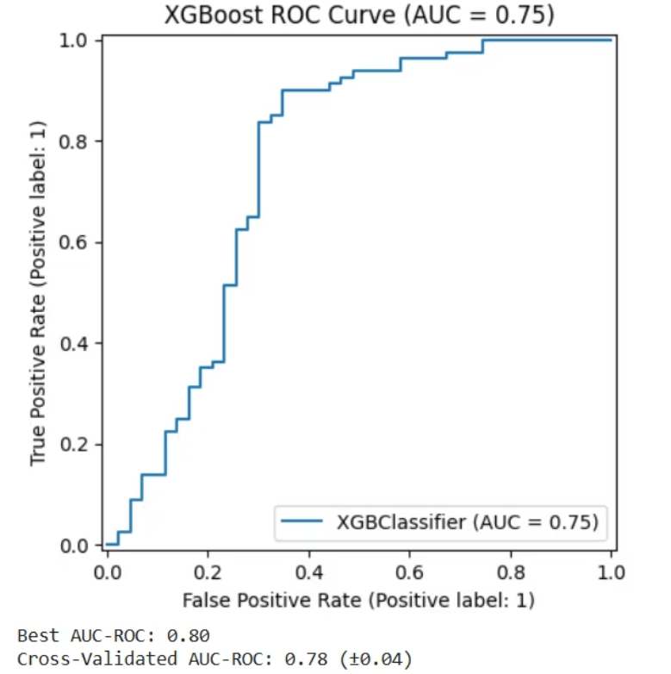
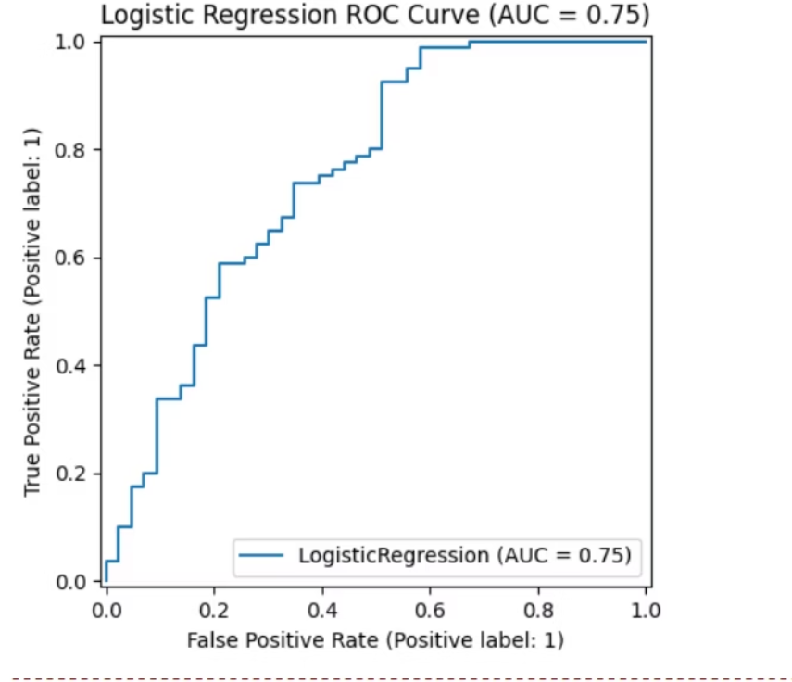

Slide 16




SHAP (SHapley Additive exPlanations)
SHAP is a powerful explainable AI tool that helps understand how each feature influences the prediction of a machine learning model.
Why Use SHAP in This Project?
To interpret individual loan decisions made by the model
To identify the most influential features globally
1
2
4
3
To build trust in AI-based financial decision-making
To ensure fair and transparent predictions

Slide 17
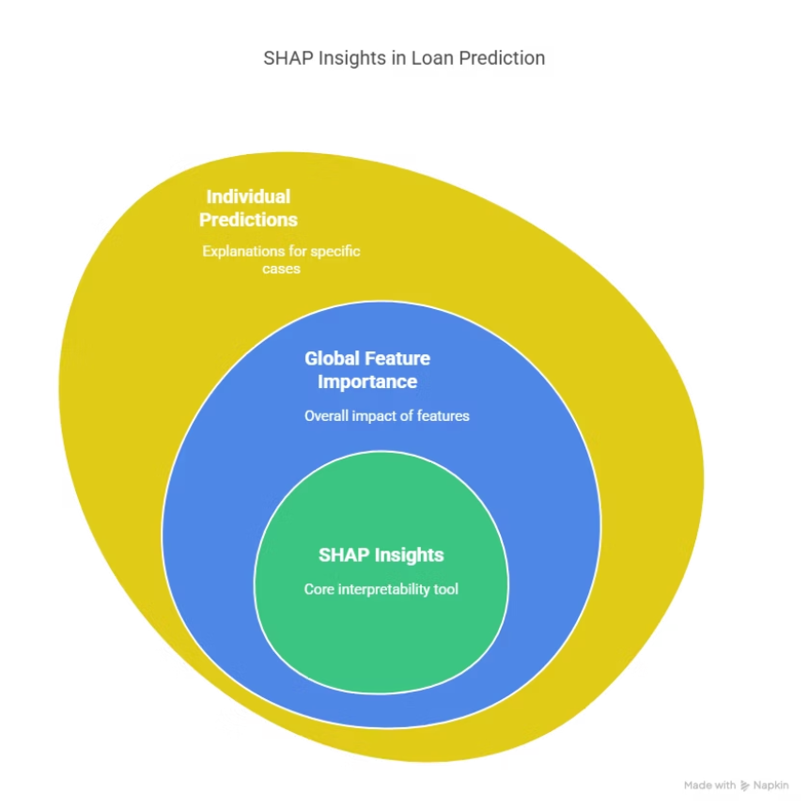
Explainable AI with SHAP Values

Slide 18
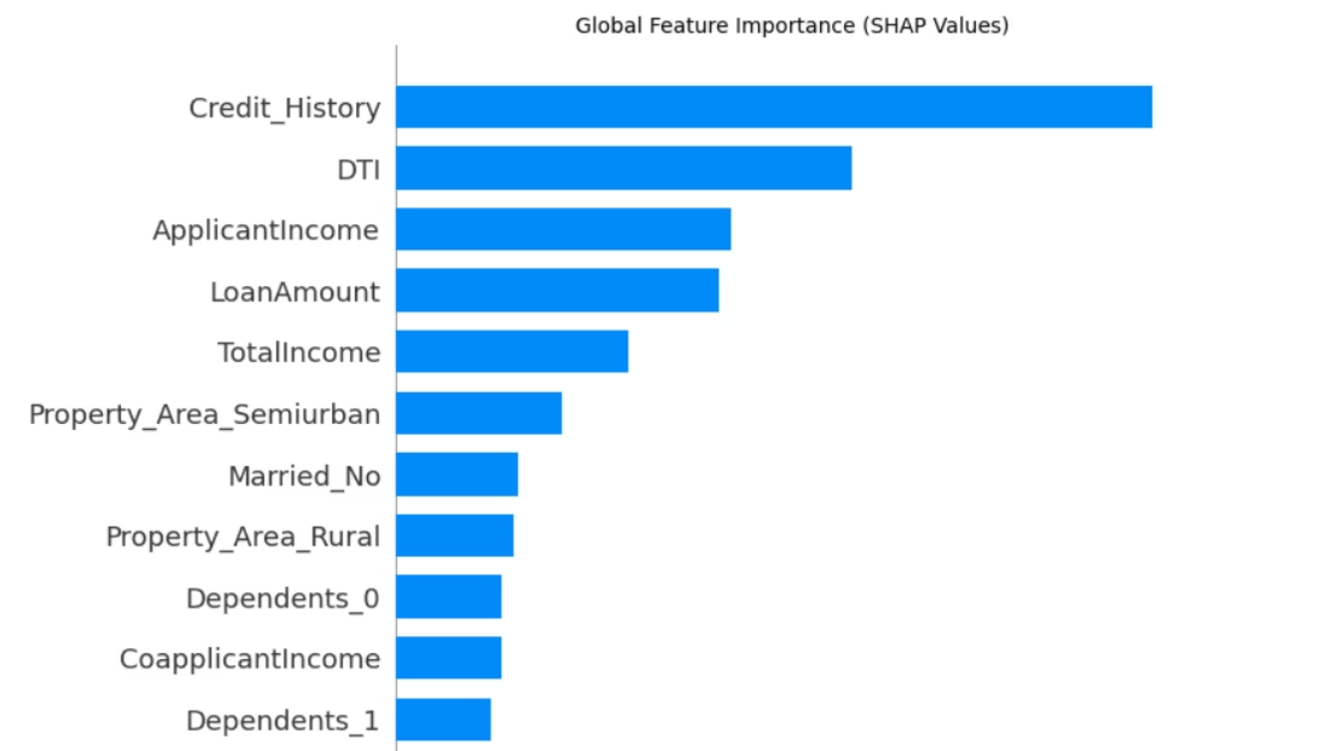
Global feature importance
Top feature: The Highest impact is of Credit _History
Identifies top contributors to loan approvals across the dataset

Slide 19
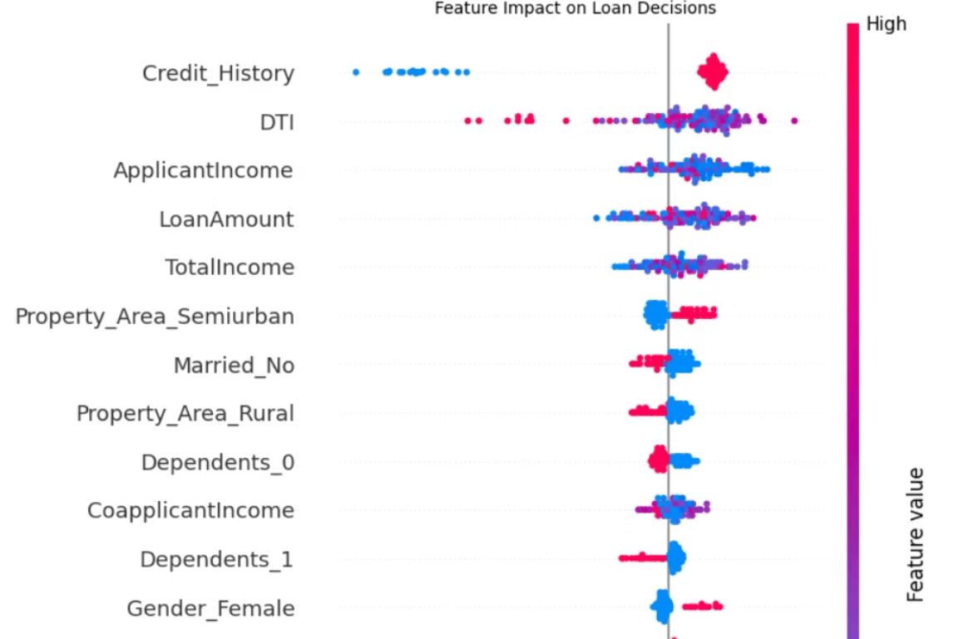
Dot Plot
Shows how each feature
pushes predictions toward
approval or rejection
Useful to understand distribution
and effect of each feature

Slide 20
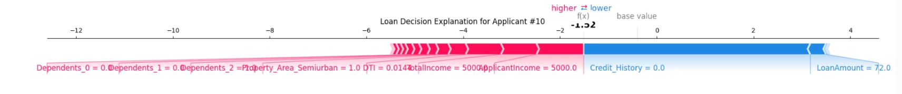
Force Plot
Breaks down why a specific applicant got approved or rejected
Each feature’s positive or negative impact is visualized clearly

Slide 21
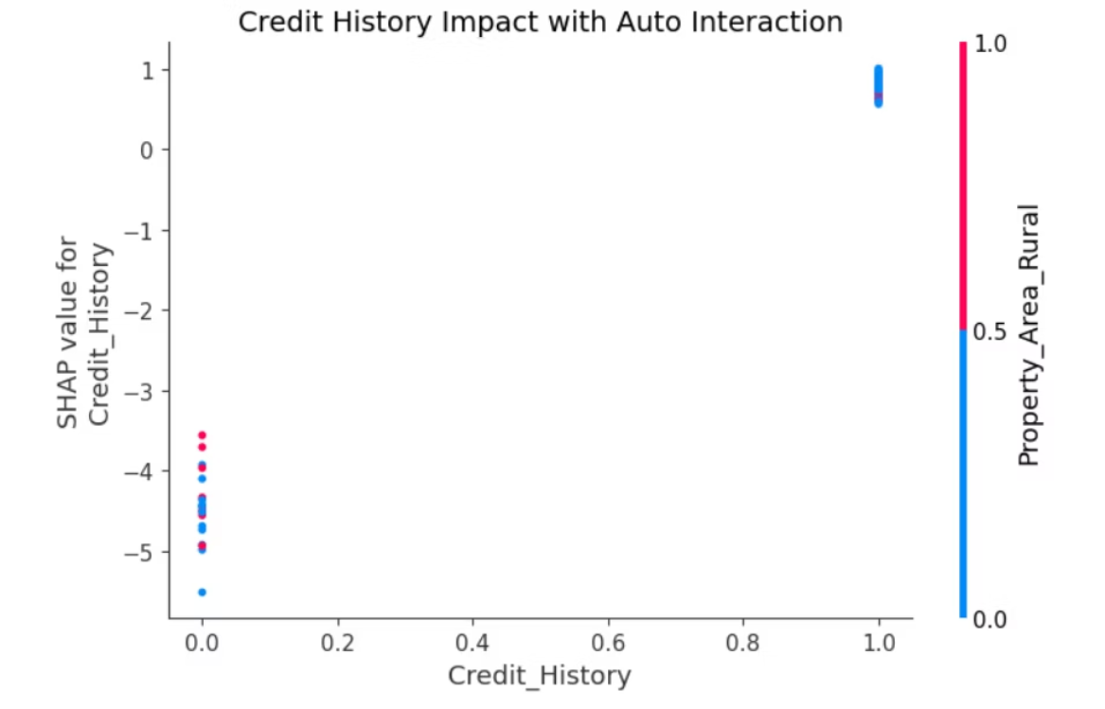
Dependence Plot
Shows how it impacts loan decisions and interacts with other features
Helps understand non-linear effects and feature interactions

Slide 22




Real World Application
Automates loan eligibility screening
Reduces manual decision bias
Improves customer experience
Provides explainability
for banks and financial institutions.
by relying on data-driven insights.
by offering faster, more accurate loan decisions.
with SHAP, enabling transparency in financial decision-making.

